Slide 1

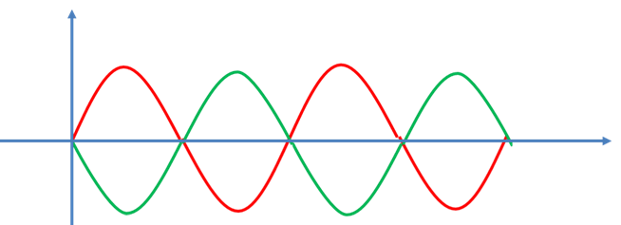
Resonance
Natural frequency
Driving frequency
Resonance: To form standing waves, the driving frequency should be equal to the natural frequency of the string. This condition is known as resonance.
The frequency required to create Resonance/Standing wave is called resonant frequency.

Slide 2
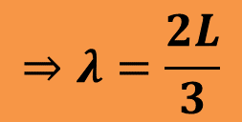

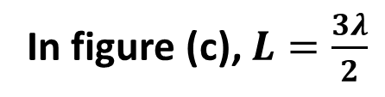
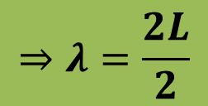
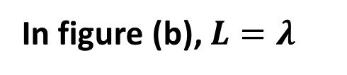

Condition for Resonant Frequency
Consider a string of length L for 3 different situations.
In figure (a), $L=\frac{λ}{2}$
$$⇒λ=2L$$
In figure (b), $L=λ$
$$⇒λ=\frac{2L}{2}$$
In figure (c), $L=\frac{3λ}{2}$
$$⇒λ=\frac{2L}{3}$$

Slide 3
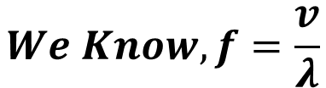
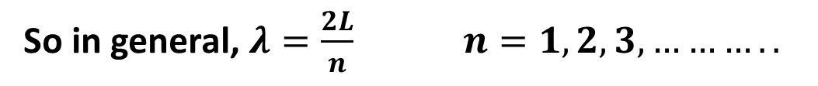
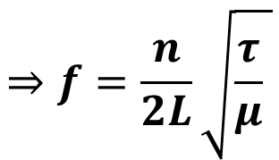
So in general, $λ=\frac{2L}{n} n=1,2,3,………..$
$$We Know, f=\frac{v}{λ}$$
$$⇒f=\frac{n}{2L}\sqrt{\frac{τ}{μ} }$$
This is the expression for resonant frequency.

Slide 4
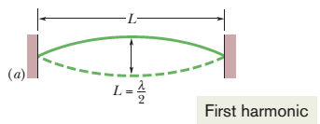
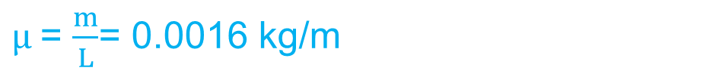
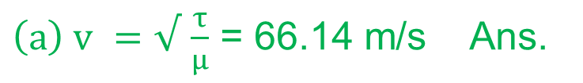
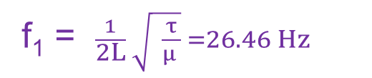
44. A 125 cm length of string has a mass 2.00 g and tension 7.00 N between fixed supports. (a) What is the wave speed for this string? (b) What is the lowest resonant frequency of this string?
$μ$= $\frac{m}{L}$= 0.0016 kg/m
${\left(a\right) v}^{ }=√$ $\frac{τ}{μ}$ = 66.14 m/s Ans.
(b) For the lowest resonant frequency, n = 1:
f₁ = $\frac{1}{2L} \sqrt{ \frac{τ}{μ }} =26.46 Hz$

Slide 5
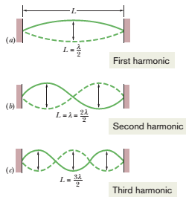
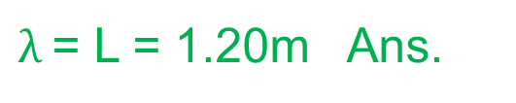
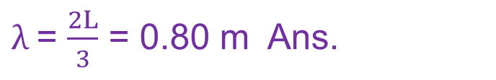
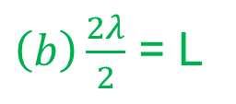
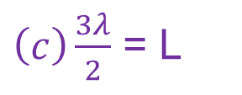
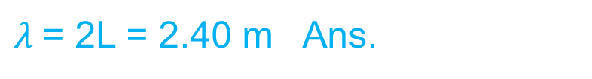
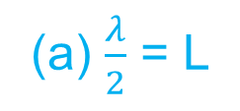
85. A 120 cm length of string is stretched between fixed supports. What are the (a) longest, (b) second longest, and (c) third longest wavelength for waves traveling on the string if standing waves are to be set up? (d) Sketch those standing waves.
(a) $\frac{λ}{2}$ = L
$λ$= 2L = 2.40 m Ans.
$\left(b\right)\frac{2λ}{2}$ = L
$λ$= L = 1.20m Ans.
$\left(c\right)\frac{3λ}{2}$ = L
$λ$= $\frac{2L}{3}$ = 0.80 m Ans.

